Slide 1

ANALYTICS AND VISUALISATION CRITIQUE ASSESSMENT
By Aditi Manuwal

Slide 2

Overview
Source: Ourworldindata.org, WHO
Audience: Public Health Professionals, Researchers and Policymakers.
COVID-19 Vaccinations share in bringing the Pandemic to an end.
4

Slide 3
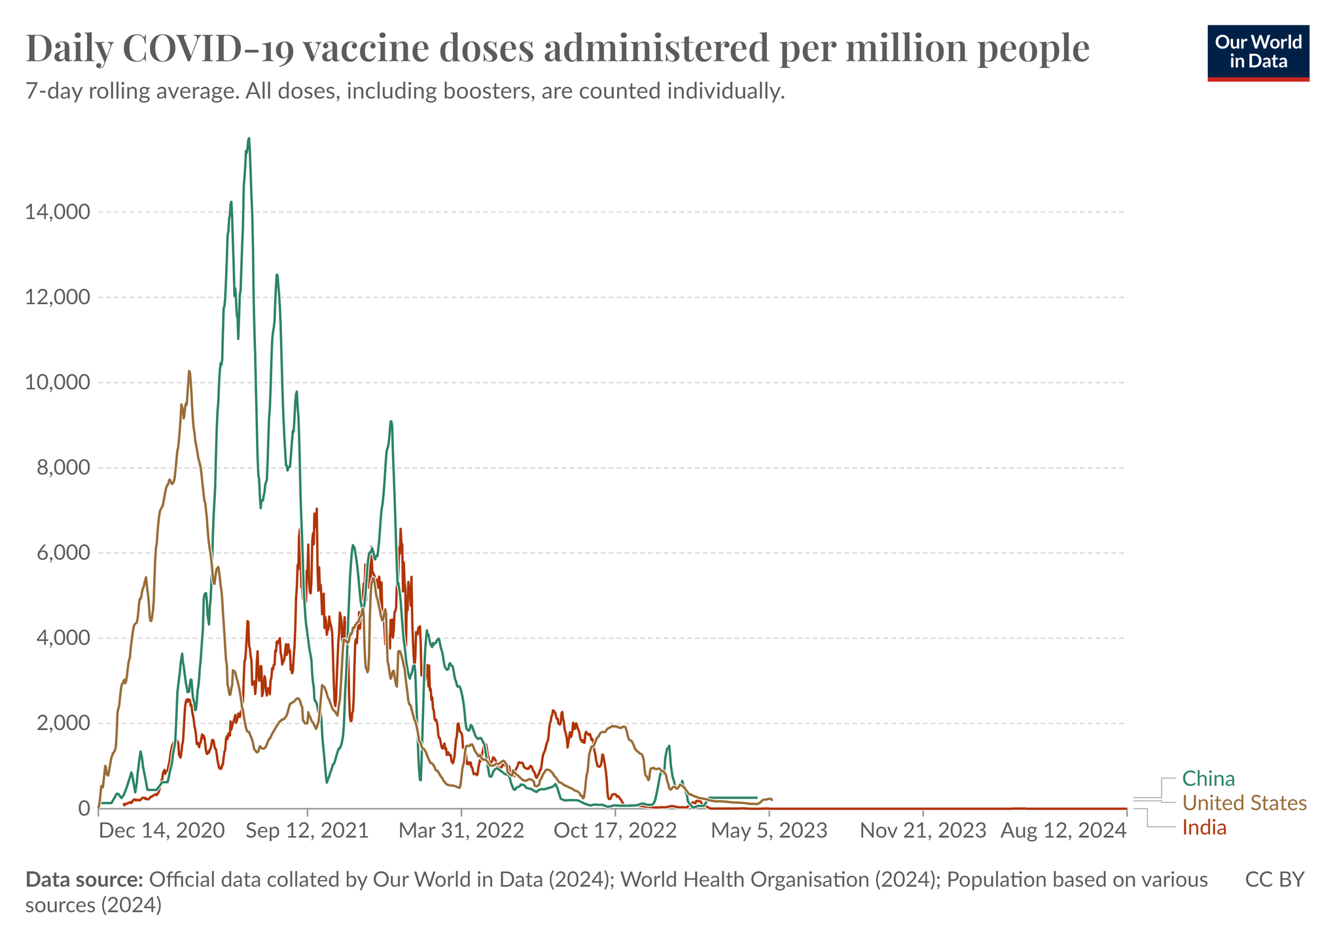
Visualisation
- A comparison of vaccine doses per million people.
-How countries have responded to evolving public health needs.
-How progression of vaccination have changed overtime in China, India and The United States.

Slide 4
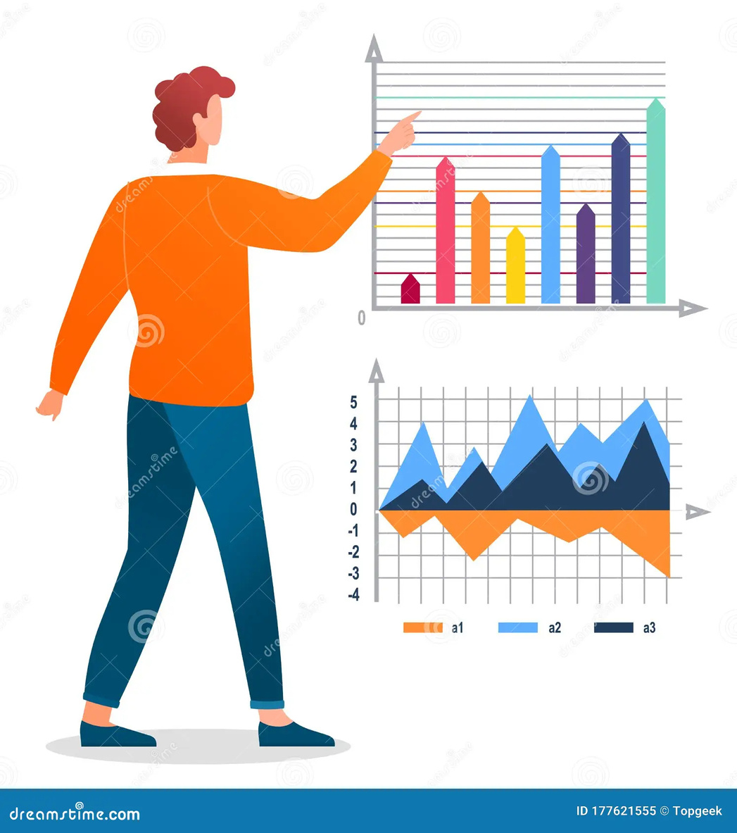
General Characteristics of the Visual
Well-designed trend lines in time-series data providing a visual narrative.
(Stephen Few: Show me the numbers)
7-Day rolling average smooths out daily variations.
(Munzner’s guidelines recommend smoothing
techniques for time-series data)
Intuitive Flow with Temporal Continuity.
(Gestalt Principles of Continuity)
3

Slide 5
Strengths
Effective representation of colors.
Significantly Visible Population Differences.
Minimised non-essential ink thereby avoiding Visual Clutter.
Comprehensive view of vaccination rates.
Direct Cross-country comparison.
5

Slide 6
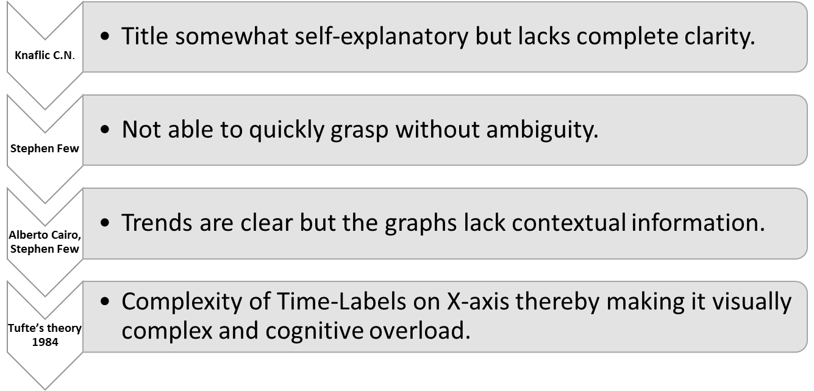
Weaknesses - Conceptual
4

Slide 7
Weaknesses - Design
Inefficient use of Gestalt Principles of Similarity and Continuity.
Ineffective Representation of Post-2023 trends. (Rensick’s thesis 2014)
Axes is not optimally scaled and inefficient use of space. (Stephen Few)
Poor usage of Visual Hierachy. (Andy Kirk)
Absence of Comparitive Emphasis.
4

Slide 8
Recommendations
Apply Gestalt Principles of Proximity, thereby improving Visual Hierarchy.
Apply Tufte’s Principle of Data Density to emphasize clarity and precision.
Reduce cognitive load.
Consider greater precision for low-activity periods.
Apply Gestalt Principle of Similarity.
Consider use of colin ware’s theory for color differentiation.
4

Slide 9
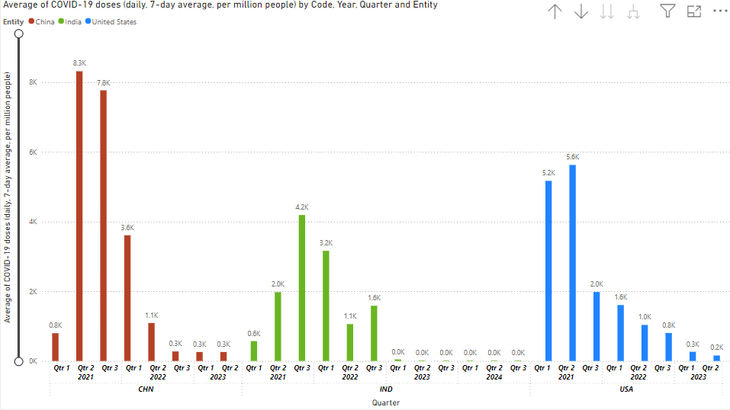
Demonstration of a applied recommendations using PowerBI
4

Slide 10
References
Cairo, A. (2019). How charts lie: Getting smarter about visual information. W.W. Norton & Company.
Few, S. (2009). Now you see it: Simple visualisation techniques for quantitative analysis. Analytics Press.
Few, S. (2012). Show me the numbers: Designing tables and graphs to enlighten (2nd ed.). Analytics Press.
Knaflic, C. N. (2015). Storytelling with data: A data visualisation guide for business professionals. Wiley.
Munzner, T. (2014). Visualisation analysis and design. CRC Press.
Rensink, R. A. (2014). The extended-vision thesis. In M. Mueller, A. E. Kaufman, & H. Hagen (Eds.), Handbook of human computation (pp. 169-182). Springer.
Tufte, E. R. (1984). The visual display of quantitative information. Graphics Press.
Ware, C. (2021). Information visualisation: Perception for design (4th ed.). Morgan Kaufmann.
Kirk, A. (n.d.). Visual hierarchy in data visualisation. Visualising Data. https://www.visualisingdata.com

